Slide 1




Slide 2

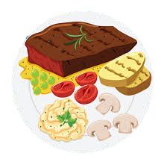




Slide 4



Extra
Plate

Slide 5

Extra
Plate

Slide 6
Extra
Plate

Slide 7




Slide 8

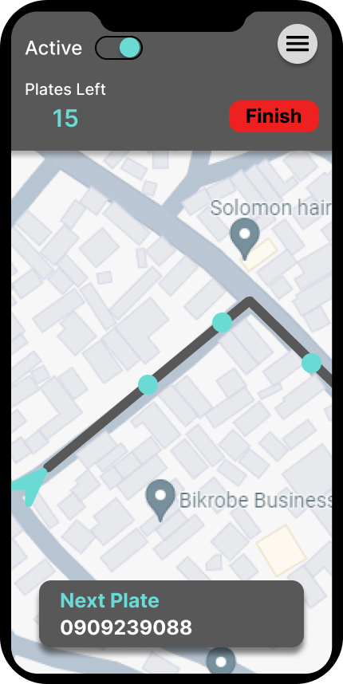

Slide 9
SDG Goal-2 : Zero Hunger

